Slide 1



COFFEE SHOP SALES ANALYSIS
Insights for Growth & Profitability
PRESENTED BY
Rishika Sharma

Slide 2

WHAT WE’LL COVER
Project Goal
Dashboard Pages and Navigation
Key Analysis & Findings
Actionable Insights
Recommendations

Slide 3
PROJECT GOAL
To analyze our sales, profit, and product performance across different regions. The goal is to identify what's working, find areas for improvement, and create a strategy for future growth.

Slide 4

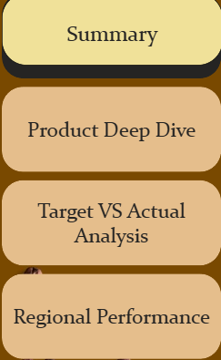
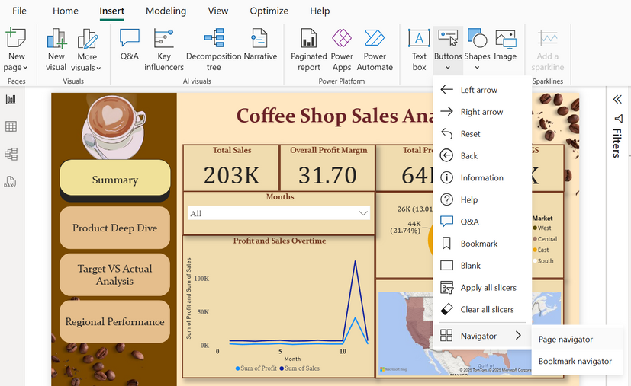
DASHBOARD PAGES AND NAVIGATION
A navigation button is a clickable object on a screen that takes you to a different page or section of a report

Slide 5

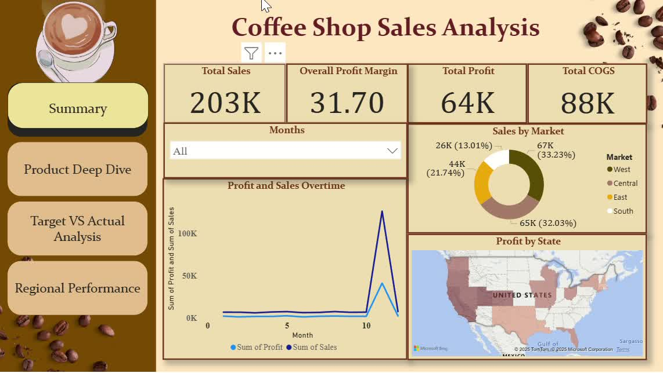

Slide 6
EXECUTIVE SUMMARY
This is the main overview page. It shows the most important numbers for the business at a glance
Key Information:
Total Sales: The total money earned from all sales ($203K).
Total Profit: The money left after all costs are paid ($64K).
Overall Profit Margin: The percentage of sales that is profit (31.70%).
Sales by Market: A donut chart showing which regions (West, Central, East, South) contribute the most to sales.
Profit and Sales Over Time: A line graph showing how sales and profit changed each month, highlighting the big spike in Month 11.
Purpose: To give a quick, high-level understanding of the business's overall health without getting into too much detail.

Slide 7
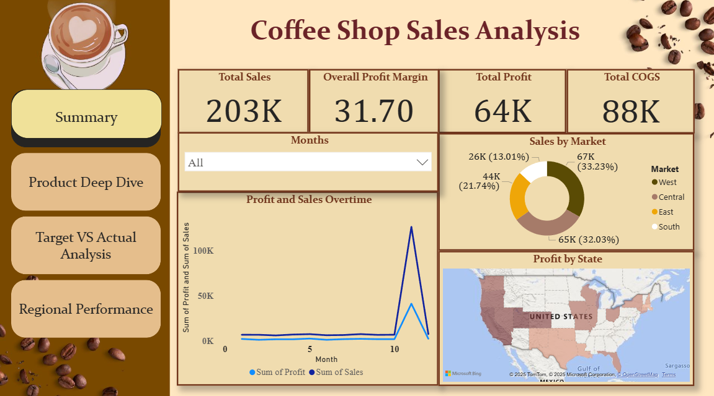

Slide 8
PRODUCT DEEP DIVE
This page focuses entirely on product performance. It helps you see which products are the most and least successful.
Key Information:
Profitability Matrix: A table that lists each product and shows its total sales, profit, margin, and cost of goods sold (COGS).
Sales by Product Type: A bar chart that ranks products by their total sales, making it easy to see the top sellers like Colombian coffee.
Filters: You can filter by product line (Beans, Leaves) and type (Decaf, Regular) to narrow down the analysis.
Purpose: To identify your star products (high sales, high profit) and those that might need changes, like price adjustments or cost reductions.

Slide 9
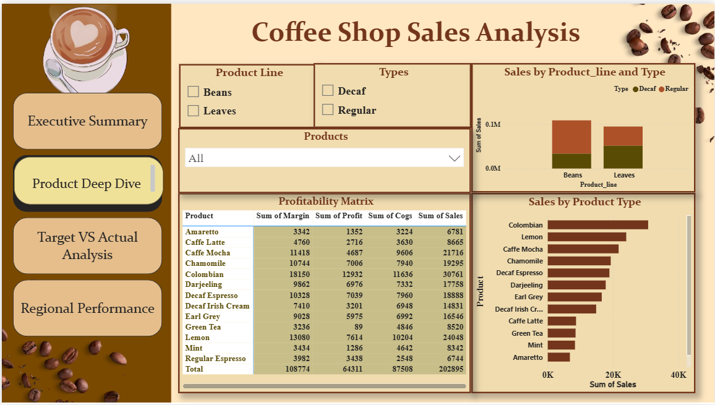

Slide 10
TARGET VS ACTUAL ANALYSIS
This page compares your actual performance against the goals or targets you set for the business.
Key Information:
Sales vs. Target Sales: A gauge chart showing how close your total sales ($203K) came to the sales target ($406K).
Profit vs. Target Profit: A similar gauge showing your actual profit ($64K) against the profit target ($129K).
Variance Analysis Table: A table that breaks down the difference between actual sales and target sales for each market, showing where you performed best or worst against expectations.
Purpose: To measure success and clearly see where the business is falling short of its goals.

Slide 11
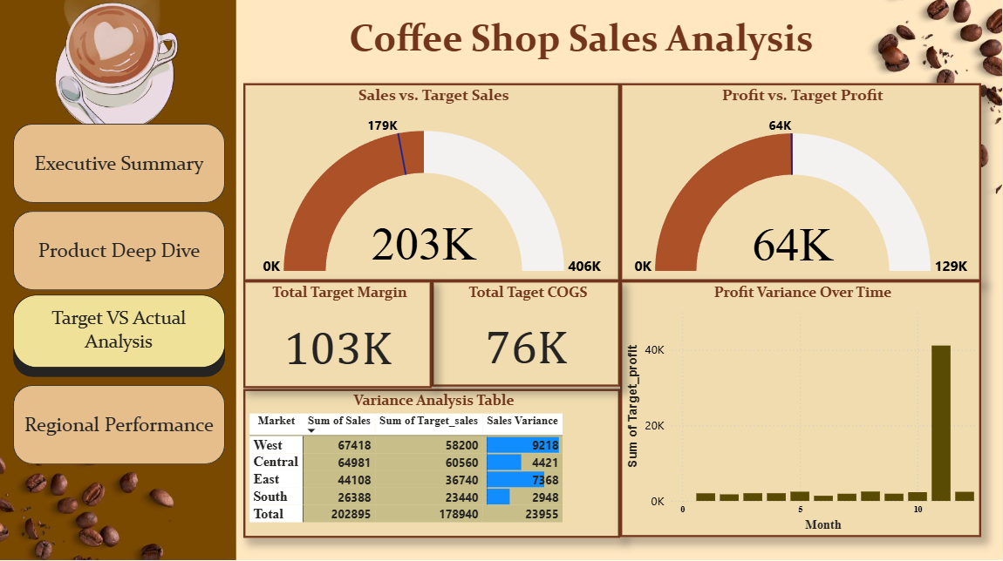

Slide 12
REGIONAL PERFORMANCE
This page provides a geographical breakdown of sales and profit, showing where your business is strongest.
Key Information:
Sales and Marketing by State: A bar chart that ranks states by their total sales.
Detailed Regional Table: A table showing the total profit, sales, and marketing expenses for each market (Central, East, South, West).
Profit by State Map: A map of the United States that visually represents which states are the most profitable.
Purpose: To identify top-performing regions and states, and to see how sales and profitability vary by location. This can help with decisions about marketing spend and expansion.

Slide 13
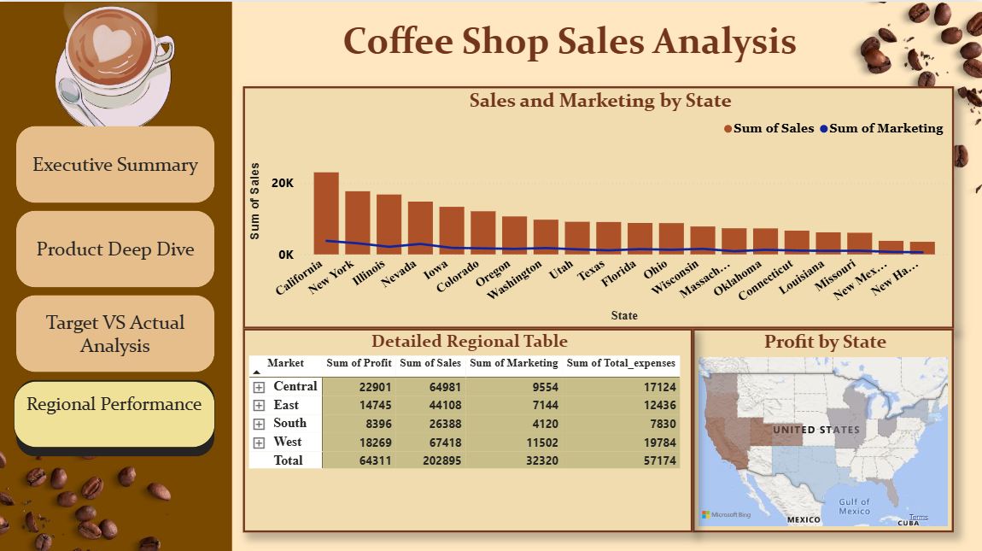

Slide 14
SUMMARY OF KEY INSIGHTS
Top Performers are Clear: Regular coffee products like Colombian and Caffe Mocha are the foundation of our sales and profit.
Profit is Not Just Sales: The Central region is our most profitable, even though the West has higher sales. This highlights an opportunity for efficiency.
We Missed Our Targets: There is a significant gap between our actual performance and our sales and profit goals.
The "Month 11" Anomaly: The unexplained spike in sales and profit in Month 11 is a major event that needs to be understood.

Slide 15
RECOMMENDATIONS
Immediate Action: Launch a marketing campaign focused on our star products, Colombian and Caffe Mocha, in the West region to boost profitability there.
Investigation: Form a small team to analyze what caused the performance spike in Month 11 and report back with findings in two weeks.
Strategic Review: Schedule a follow-up meeting to review our current sales and profit targets to ensure they are realistic for the next quarter.
Decision Needed: Seek approval to adjust the pricing on high-selling but low-profit products like Decaf Espresso.

Slide 16
THANK YOU
I Appreciate Your Time

